Slide 1
Adv. I/O, Multicast, etc…
Advanced I/O functions, Multicast addresses, Sessions, Multicast on a LAN, Multicast on a WAN, IGMP, Socket options
Chapter 14 and 21

Slide 2
Advanced I/O
I/O Timeout
Variants of Read & Write
Socket receiver buffer content size

Slide 3
Socket Timeout
Alarm (SIGALRM) + Signal handler
Select
SO_RCVTIMEO, SO_SNDTIMEO

Slide 4
Alarm + sig.handler: Connect
#include "unp.h“ static void connect_alarm(int);
int connect_timeo(int sockfd, const SA *saptr, socklen_t salen, int nsec) { Sigfunc *sigfunc; int n;
sigfunc = Signal(SIGALRM, connect_alarm); if (alarm(nsec) != 0) err_msg("connect_timeo: alarm was already set");
if ( (n = connect(sockfd, saptr, salen)) < 0) { close(sockfd); if (errno == EINTR) errno = ETIMEDOUT; }
alarm(0); /* turn off the alarm */ Signal(SIGALRM, sigfunc); /* restore previous signal handler */ return(n); }
static void connect_alarm(int signo) { return; /* just interrupt the connect() */ }
void Connect_timeo(int fd, const SA *sa, socklen_t salen, int sec){ if (connect_timeo(fd, sa, salen, sec) < 0) err_sys("connect_timeo error"); }

Slide 5
Alarm + sig.handler: Recv
Signal(SIGALRM, sig_alrm);
while (Fgets(sendline, MAXLINE, fp) != NULL) {
Sendto(sockfd, sendline, strlen(sendline), 0, pservaddr, servlen);
alarm(5);
if ( (n = recvfrom(sockfd, recvline, MAXLINE, 0, NULL, NULL)) < 0) {
if (errno == EINTR)
fprintf(stderr, "socket timeout\n");
else
err_sys("recvfrom error");
} else {
alarm(0);
recvline[n] = 0; /* null terminate */
Fputs(recvline, stdout);
}
}

Slide 6
select
if (readable_timeo(sockfd, 5) == 0) { fprintf(stderr, "socket timeout\n");
} else {
n = Recvfrom(sockfd, recvline, MAXLINE, 0, NULL, NULL); recvline[n] = 0; /* null terminate */ Fputs(recvline, stdout);
}
int readable_timeo(int fd, int sec){
fd_set rset;
struct timeval tv;
FD_ZERO(&rset);
FD_SET(fd, &rset);
tv.tv_sec = sec;
tv.tv_usec = 0;
return(select(fd+1, &rset, NULL, NULL, &tv));
/* 4> 0 if descriptor is readable */
}

Slide 7
Socket Option
struct timeval tv; tv.tv_sec = 5; tv.tv_usec = 0; Setsockopt(sockfd, SOL_SOCKET, SO_RCVTIMEO, &tv, sizeof(tv));
while (Fgets(sendline, MAXLINE, fp) != NULL) { Sendto(sockfd, sendline, strlen(sendline), 0, pservaddr, servlen); n = recvfrom(sockfd, recvline, MAXLINE, 0, NULL, NULL); if (n < 0) { if (errno == EWOULDBLOCK) { fprintf(stderr, "socket timeout\n"); continue; } else err_sys("recvfrom error"); } recvline[n] = 0; /* null terminate */ Fputs(recvline, stdout); } }

Slide 8
recv and send
#include <sys/socket.h>
ssize_t recv(int sockfd, void *buff, size_t nbytes, int flags);
ssize_t send(int sockfd, const void *buff, size_t nbytes, int flags);
Flag | Description | Recv | Send
MSG_DONTROUTE | Bypass routing table lookup |  | x
MSG_DONTWAIT | Only this operation is in nonblocking | x | x
MSG_OOB | Send or receive out-of-band data | x | x
MSG_PEEK | Peek at incoming message | x
MSG_WAITALL | Wait for all the data | x

Slide 9
readv and writev
#include <sys/socket.h>
ssize_t readv(int filedes, const struct iovec *iov, int iovcnt);
ssize_t writev(int filedes, const struct iovec *iov, int iovcnt);
struct iovec {
void *iov_base;
size_t iov_len;
};
Read/Write from multiple buffers

Slide 10
recvmsg and sendmsg
#include <sys/socket.h>
ssize_t recvmsg(int sockfd, struct msghdr *msg, int flags);
ssize_t sendmsg(int sockfd, struct msghdr *msg, int flags);
struct msghdr {
void *msg_name;
socklen_t msg_namelen;
struct iovec *msg_iov;
int msg_iovlen;
void *msg_control;
socklen_t msg_controllen;
int flags;
};
Most General of all I/O functions

Slide 11
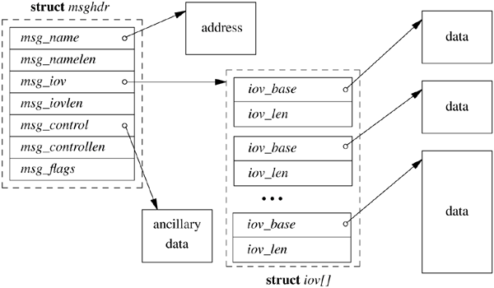
msghdr{}

Slide 12
msg_flags
Flag | Description | Examined by send flags sendto flags sendmsg flags | Examined by recv flags recvfrom flags recvmsg flags | Returned by: recvmsg msg_flags
MSG_DONTROUTE | Bypass routing table lookup | X
MSG_DONTWAIT | Only this operation is in nonblocking | X | X
MSG_PEEK | Peek at incoming message |  | X
MSG_WAITALL | Wait for all the data |  | X
MSG_EOR | End-of-record | X |  | X
MSG_OOB | Not used for TCP oob | X | X | X
MSG_BCAST | Datagram was a link-layer broadcast |  |  | X
MSG_MCAST | Datagram was a link-layer multicast |  |  | X
MSG_TRUNC | Datagram was truncated |  |  | X
MSG_CTRUNC | Ancillary data was truncated |  |  | X
MSG_NOTIFICATION | Used by SCTP, indicate event, not data. |  |  | X

Slide 13
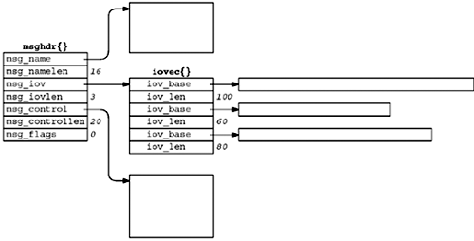
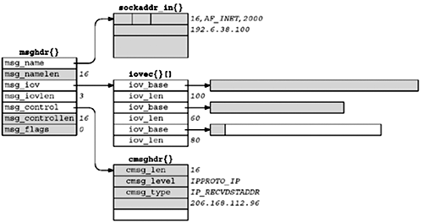
recvmsg; UDP 170 bytes, from 192.168.38.100:2000
Before call
After call

Slide 14
Summary
Function | Any descriptor | Only socket descriptor | Single read/write buffer | Scatter/ gather read/write | Optional flags | Optional peer address | Optional control information
read, write | X |  | X
readv, writev | X |  |  | X
recv, send |  | X | X |  | X
recvfrom, sendto |  | X | X |  | X | X
recvmsg, sendmsg |  | X |  | X | X | X | X

Slide 15
Ancillary Data // Control Data
14.6, p 395

Slide 16
How much data is queued?
Non-blocking I/O
MSG_PEEK flag
FIONREAD

Slide 17
Sockets and Standard I/O
ANSI C, Standard I/O library
Buffered
Directional
r, w or rw
seek → wont work on sockets
Buffering
Fully buffered, I/O when buffer full or fflushed.
Line buffered, I/O when newline is encountered
Unbuffered

Slide 18
Advanced Polling
/dev/poll
kqueue
epoll
Libev or libevent
http://www.kegel.com/c10k.html

Slide 19
Multicast

Slide 20
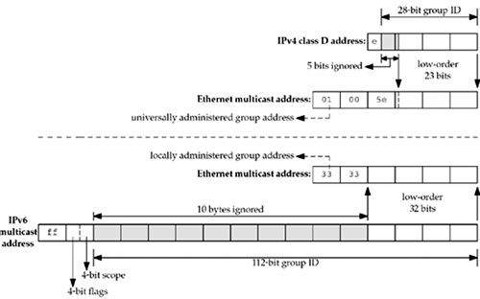
Multicast Addresses
IPv4
Class D; 224.0.0.0 – 239.255.255.255
IPv6
ff:[*]

Slide 21
Specials
224.0.0.1 all-hosts
224.0.0.2 all-routers
ff01::1, ff02::1 all-nodes
ff01::2, ff02::2, ff05::2 all-routers
https://en.wikipedia.org/wiki/Multicast_address

Slide 22
Scope | IPv6 | IPv4
 | Scope | TTL | Adm.Scope
Interface-local | 1 | 0
Link-local | 2 | 1 | 224.0.0.0 – 224.0.0.255
Admin-local | 4
Site-local | 5 | <32 | 239.255.0.0 – 239.255.255.255
Organization-local | 8 |  | 239.192.0.0 – 239.195.255.255
Global | 14 | <255 | 224.0.1.0 – 238.255.255.255

Slide 23
Multicast Session
IP.src:Tp.srcport + protocol + IP.dst:Tp.dstport == Session
Multicast group + transport-protocol + port == Session
Multiple Sessions / Groups

Slide 24
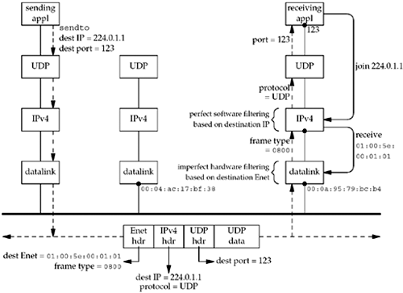
Multicast on LAN
Add Ethernet
Multicast
Stuff.
Switch book
GMRP GARP

Slide 25
Multicast on WAN
Distribute from one (or multiple) networks, to one or multiple other networks.
Where are the sources or destinations?
Routing
Internet Group Management Protocol (IGMP)

Slide 26
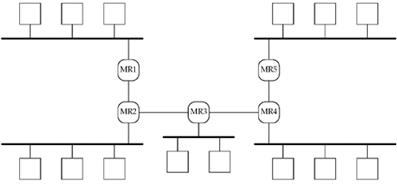
Multicast on WAN

Slide 27
Multicast on WAN

Slide 28
Multicast on WAN

Slide 29
Multicast Socket Options
Command | Datatype | Description
IP_ADD_MEMBERSHIP | struct ip_mreq | Join mcast group
IP_DROP_MEMBERSHIP | struct ip_mreq | Leave mcast group
IP_BLOCK_SOURCE | struct ip_mreq_source | Block source from a joined group
IP_UNBLOCK_SOURCE | struct ip_mreq_source | Unblock source from a joined group
IP_ADD_SOURCE_MEMBER | struct ip_mreq_source | Join source-specific group
IP_DROP_SOURCE_MEMBER | struct ip_mreq_source | Leave source-specific group
IPV6_JOIN_GROUP | struct ipv6_mreq | Join mcast group
IPV6_LEAVE_GROUP | struct ipv6_mreq | Leave mcast group
MCAST_JOIN_GROUP | struct group_req | Join mcast group
MCAST_LEAVE_GROUP | struct group_req | Leave mcast group
MCAST_BLOCK_SOURCE | struct group_source_req | Block source from a joined group
MCAST_UNBLOCK_SOURCE | struct group_source_req | Unblock source from a joined group
MCAST_JOIN_SOURCE_GROUP | struct group_source_req | Join source-specific group
MCAST_LEAVE_SOURCE_GROUP | struct group_source_req | Leave source-specific group

Slide 30
Join a Group
struct group_req request;
request.gr_interface=ifindex;
request.gr_group=socketAddress_with_type_address;
setsockopt(sockfd, sa->family, MCAST_JOIN_GROUP, &request, sizeof(request);

Slide 31
Status of Internet Multicast today
AFAIK; not widely deployed

